Slide 1

Carta de la identidad
carismática
de la Familia Salesiana
de Don Bosco
Grafica
Elena Cristino

Slide 2
2012
Carta de Comunión
Carta de la Identidad carismática
Carta de la Misión
1995
2000

Slide 3
En esta nueva Carta están descritos los elementos característicos
y los que caracterizan
la Familia Salesiana.

Slide 4
La Carta de Identidad comprende
e integra las dos Cartas precedentes
misión
relaciones
espíritu
describe
formación
Métodos de educación y de evangelización

Slide 5
La Carta de Identidad debería llevar producir a los siguientes frutos
REFORZAMIENTO
DE LA UNIDAD
DEL SENTIDO
DE PERTENENCIA
DE LA SIGNIFICATIVIDAD
DE LA FAMILIA

Slide 6

Don Pascual Chávez Villanueva
Si creemos en la Familia Salesiana, encontraremos
el entusiasmo, los recursos interiores y las modalidades operativas para hacerla
crecer en su identidad.
Entonces, nuestra Familia
gozará de una vitalidad tal
que atraiga nuevas vocaciones.
Notes:
3-D rings
(Intermediate)
To reproduce the effects on this slide, do the following:
On the Home tab, in the Slides group, click Layout, and then click Blank.
On the Home tab, in the Drawing group, click Shapes, and then under Basic Shapes click Donut (third row, second option from the left). On the slide, drag to draw a donut shape.
Select the donut shape. Drag the yellow diamond adjustment handle to the left to decrease the width of the donut shape.
Under Drawing Tools, on the Format tab, in the Size group, do the following:
In the Shape Height box, click 4.17”.
In the Shape Width box, click 4.17”.
Under Drawing Tools, on the Format tab, in the Shape Styles group, click the arrow next to Shape Fill, and then under Theme Colors click Aqua, Accent 5, Darker 25% (fifth row, ninth option from the left).
Under Drawing Tools, on the Format tab, in the Shape Styles group, click the arrow next to Shape Outline, and then click No Outline.
Under Drawing Tools, on the Format tab, in the bottom right corner of the Shape Styles group, click the Format Shape dialog box launcher. In the Format Shape dialog box, click 3-D Format in the left pane, and then do the following in the 3-D Format pane:
Under Bevel, click the button next to Top, and then under Bevel click Convex (second row, third option from the left). Next to Top, in the Width box, enter 5 pt, and then in the Height box, enter 5 pt. Click the button next to Bottom, and then under Bevel click Convex (second row, third option from the left). Next to Bottom, in the Width box, enter 5 pt, and then in the Height box, enter 5 pt.
Under Depth, click the button next to Color, and then under Theme Colors click Aqua, Accent 5, Darker 25% (fifth row, ninth option from the left). In the Depth box, enter 30 pt.
Under Surface, click the button next to Material, and then under Special Effect click Soft Edge (second option from the left). Click the button next to Lighting, and then under Neutral click Three Point (first row, first option from the left). In the Angle box, enter 30°.
Also in the Format Shape dialog box, click Shadow in the left pane, and then do the following in the Shadow pane:
Click the button next to Presets, and then under Outer click Offset Diagonal Bottom Left (first row, third option from the left).
In the Blur box, enter 11 pt.
In the Angle box, enter 90°.
Also in the Format Shape dialog box, click 3-D Rotation in the left pane. In the 3-D Rotation pane, click the button next to Presets, and then under Parallel click Off Axis 1 Top (second row, third option from the left).
On the Insert tab, in the Text group, click Text Box. On the slide, drag to draw a text box.
Enter text in the text box (Note: Enter three spaces before and after the text), select the text, and then on the Home tab, in the Font group, select Franklin Gothic Medium from the Font list and then select 24 from the Font Size list.
On the Home tab, in the Paragraph group, click Center to center the text in the text box.
Select the text box. Under Drawing Tools, on the Format tab, in the WordArt Styles group, click Text Effects, point to Transform, and then under Warp click Can Down (fourth row, fourth option from the left).
Drag the text box onto the donut shape.
On the text box, drag the pink diamond and blue adjustment handles to adjust the amount of text warp so that it matches the curve of the donut shape.
Under Drawing Tools, on the Format tab, in the WordArt Styles group, click the arrow next to Text Fill, point to Gradient, and then click More Gradients. In the Format Text Effects dialog box, click Text Fill in the left pane, select Gradient fill in the Text Fill pane, and then do the following:
In the Type list, select Linear.
Click the button next to Direction, and then click Linear Right (first row, fourth option from the left).
In the Angle box, enter 0°.
Under Gradient stops, click Add or Remove until three stops appear in the drop-down list.
Also under Gradient stops, customize the gradient stops that you added as follows:
Select Stop 1 from the list, and then do the following:
In the Stop position box, enter 0%.
Click the button next to Color, and then under Theme Colors click White, Background 1 (first row, first option from the left).
In the Transparency box, enter 30%.
Select Stop 2 from the list, and then do the following:
In the Stop position box, enter 77%.
Click the button next to Color, and then under Theme Colors click White, Background 1 Darker 15% (third row, first option from the left).
In the Transparency box, enter 0%.
Select Stop 3 from the list, and then do the following:
In the Stop position box, enter 100%.
Click the button next to Color, and then under Theme Colors click White, Background 1, Darker 35% (fifth row, first option from the left).
In the Transparency box, enter 0%.
Press and hold CTRL, and then select the donut shape and the text box. On the Home tab, in the Clipboard group, click the arrow under Paste, and then click Duplicate.
Press and hold CTRL, select the second donut shape and text box, and then drag on the slide slightly above and to the right of the first donut shape.
Click in the second text box and edit the text.
Select the second donut shape. Under Drawing Tools, on the Format tab, in the Size group, do the following:
In the Shape Height box, enter 3.75”.
In the Shape Width box, enter 3.75”.
Drag the second text box onto the second donut shape.
On the second text box, drag the pink diamond and blue adjustment handles to adjust the amount of text warp so that it matches the curve of the second donut shape.
Select the second donut shape. Under Drawing Tools, on the Format tab, in the Shape Styles group, click the arrow next to Shape Fill, and then under Theme Colors click Purple, Accent 4, Darker 25% (fifth row, eighth option from the left).
On the Home tab, in the bottom right corner of the Drawing group, click the Format Shape dialog box launcher. In the Format Shape dialog box, click 3-D Format in the left pane. In the 3-D Format pane, under Depth, click the button next to Color, and then under Theme Colors click Purple, Accent 4, Darker 25% (fifth row, eighth option from the left).
Press and hold CTRL, and then select the second donut shape and text box. On the Home tab, in the Clipboard group, click the arrow under Paste, and then click Duplicate.
Drag the third donut shape and text box slightly above and to the left of the second donut shape.
Click the third text box and edit the text.
Press and hold CTRL, and then select the third donut shape and text box. Under Drawing Tools, on the Format tab, in the Size group, do the following:
In the Shape Height box, enter 3.33”.
In the Shape Width box, enter 3.33”.
Drag the third text box onto the third donut shape.
On the third text box, drag the pink diamond and blue adjustment handles to adjust the amount of text warp so that it matches the curve of the third donut shape.
Select the third donut shape. Under Drawing Tools, on the Format tab, in the Shape Styles group, click the arrow next to Shape Fill, and then under Theme Colors click Olive Green, Accent 3, Darker 25% (fifth row, seventh option from the left).
On the Home tab, in the bottom right corner of the Drawing group, click the Format Shape dialog box launcher. In the Format Shape dialog box, click 3-D Format in the left pane. In the 3-D Format pane, under Depth, click the button next to Color, and then under Theme Colors click Olive Green, Accent 3, Darker 25% (fifth row, seventh option from the left).
Select the first donut shape. On the Home tab, in the Drawing group, click Arrange, and then click Send to Back.
To reproduce the background effects on this slide, do the following:
Right-click the slide background area, and then click Format Background. In the Format Background dialog box, click Fill in the left pane, select Gradient fill in the Fill pane, and then do the following:
In the Type list, select Linear.
Click the button next to Direction, and then click Linear Up (second row, second option from the left).
Under Gradient stops, click Add or Remove until two stops appear in the drop-down list.
Also under Gradient stops, customize the gradient stops that you added as follows:
Select Stop 1 from the list, and then do the following:
In the Stop position box, enter 31%.
Click the button next to Color, and then under Theme Colors click White, Background 1 (first row, first option from the left).
Select Stop 2 from the list, and then do the following:
In the Stop position box, enter 100%.
Click the button next to Color, click More Colors, and then in the Colors dialog box, on the Custom tab, enter values for Red: 200, Green: 201, Blue: 193.

Slide 7
Haz clic en los capítulos
1
La Familia Salesiana en la Iglesia
2
La misión de la Familia Salesiana
3
La espiritualidad de la Familia Salesiana
4
Formación para la comunión y la misión en la Familia Salesiana
5
Composición y animación de la Familia Salesiana

Slide 8

Capítulos
2
3
4
5
1
La Familia Salesiana en la Iglesia

Slide 9
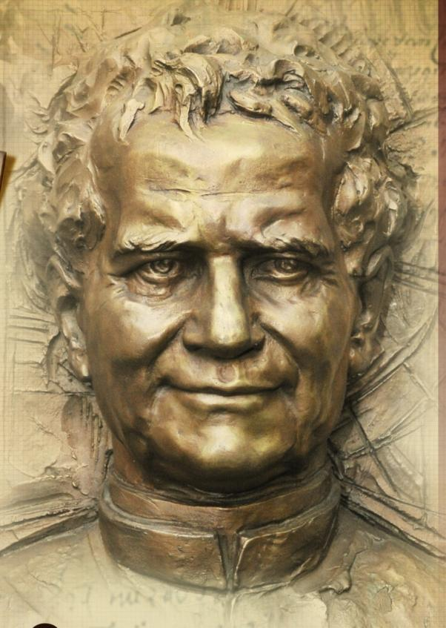
1
La Familia Salesiana en la Iglesia
Art. 1
Fundador
de una gran
Familia
espiritual
y apostólica

Slide 10

1
La Familia Salesiana en la Iglesia
Art. 1
  Pía Sociedad de San Francisco de Sales
  Instituto de las
  Hijas de María Auxiliadora
  Salesianos
  Cooperadores
  ADMA
  [Asociación de
  María Auxiliadora]
Notes:
3-D tiles with texture
(Intermediate)
To reproduce the first rectangle on this slide, do the following:
On the Home tab, in the Slides group, click Layout, and then click Blank.
On the Home tab, in the Drawing group, click Shapes, and then under Rectangles click Rectangle (first option from the left). On the slide, drag to draw a rectangle.
Select the rectangle. Under Drawing Tools, on the Format tab, in the Size group, do the following:
In the Shape Height box, enter 2.22”.
In the Shape Width box, enter 2.68”.
Right-click the rectangle and select Edit Text. Enter 1, and then select the text. On the Home tab, in the Font group, in the Font list select Calibri, and in the Font Size box enter 100 pt.
On the Home tab, in the Paragraph group, click Center.
Under Drawing Tools, on the Format tab, in the WordArt Styles group, in the bottom right corner, click the Format Text Effects dialog box launcher. In the Format Text Effects dialog box, click Text Fill in the left pane. In the Text Fill pane, select Solid fill, click the button next to Color, and then under Theme Colors click Tan, Background 2, Darker 25% (third row, third option from the left).
Also in the Format Text Effects dialog box, click Shadow in the left pane, and in the Shadow pane, under Presets , under Inner, click Inside Diagonal Top Left (first row, first option from the left).
Select the rectangle. On the Home tab, in the bottom right corner of the Drawing group, click the Format Shape dialog box launcher. In the Format Shape dialog box, click Fill in the left pane. Select Picture or texture fill in the Fill pane, click the button next to Texture, and then click Recycled Paper (third row, fourth option from the left).
Also in the same dialog box (now the Format Picture dialog box), click Line Color in the left pane, and then in the Line Color pane, select No line.
Also in the Format Picture dialog box, click Shadow in the left pane. In the Shadow pane, click the button next to Presets, and then under Outer click Offset Diagonal Bottom Right (first row, first option from the left).
Also in the Format Picture dialog box, click 3-D Format in the left pane, and then in the 3-D Format pane do the following:
Under Bevel, in the Top list, select Angle (second row, first option from the left).
Next to Top, in the Width box, enter 6 pt, and in the Height box, enter 6 pt.
Under Bevel, in the Bottom list, select Circle (first row, first option from the left).
Next to Bottom, in the Width box, enter 6 pt, and in the Height box, enter 6 pt.
Under Depth, in the Depth box, enter 4.5 pt.
Under Surface, in the Material list, under Standard, select Warm Matte (second option from the left).
Under Surface, in the Lighting list, under Neutral, select Soft (first row, third option from the left), and in the Angle box, enter 280°.
Also in the Format Picture dialog box, click 3-D Rotation in the left pane. In the 3-D Rotation pane, in the Presets list, under Perspective, select Perspective Above (second row, first option from the left), and then do the following:
In the Y box, enter 300°.
In the Perspective box, enter 60°.
Drag the rectangle to the left side of the slide.
To reproduce the other rectangles on this slide, do the following:
Select the rectangle. On the Home tab, in the Clipboard group, click the arrow under Paste and select Duplicate.
Select the text in the second rectangle, and enter 2. On the Home tab, in the Font group, click the arrow next to Font Color and then under Theme Colors select Black, Text 1, Lighter 50% (second row, second option from the left).
Select the second rectangle. On the Home tab, in the bottom right corner of the Drawing group, click the Format Shape dialog box launcher. In the Format Shape dialog box, click Fill in the left pane, and in the Fill pane select Picture or texture fill. In the Texture list select Granite (third row, second option from the left).
Also in the same dialog box (now the Format Picture dialog box), click 3-D Rotation in the left pane, and in the 3-D Rotation pane, in the Presets list, under Perspective select Perspective Contrasting Right (third row, first option from the left).
Also in the Format Picture dialog box, click Shadow in the left pane, and in the Shadow pane, in the Presets list, under Perspective, select Perspective Diagonal Upper Left (first row, first option from the left).
Drag the second rectangle to the center of the slide.
Select the first rectangle. On the Home tab, in the Clipboard group, click the arrow below Paste and select Duplicate.
Select the text in the third rectangle and enter 3. On the Home tab, in the Font group, click the arrow next to Font Color, and then under Theme Colors select White, Background 1, Darker 50% (sixth row, first option from the left).
Select the third rectangle. Under Drawing Tools, on the Format tab, in the Size group, do the following:
In the Shape Height box, enter 3.0”.
In the Shape Width box, enter 3.26”.
With the third rectangle still selected, on the Home tab, in the bottom right corner of the Drawing group, click the Format Shape dialog box launcher. In the Format Shape dialog box, click Fill in the left pane, and in the Fill pane select Picture or texture fill. In the Texture list select White Marble (second row, fifth option from the left).
Also in the same dialog box (now the Format Picture dialog box), click 3-D Rotation in the left pane, and in the 3-D Rotation pane, under Rotation, do the following:
In the X box, enter 63.7°.
In the Y box, enter 319.3°.
In the Z box, enter 289.4°.
In the Perspective box, enter 90°.
Drag the third rectangle to the right side of the slide.
To reproduce the background effects on this slide, do the following:
Right-click the slide background area, and then click Format Background. In the Format Background dialog box, click Fill in the left pane, select Gradient fill in the right pane, and then do the following:
In the Type list, select Linear.
In the Direction list, click Linear Up (second row, second option from the left).
Under Gradient stops, click Add or Remove until two stops appear in the drop-down list.
Also under Gradient stops, customize the gradient stops as follows:
Select Stop 1 from the list, and then do the following:
In the Stop position box, enter 0%.
Click the button next to Color, and then click More Colors, and then in the Colors dialog box, on the Custom tab, enter values for Red: 162, Green: 152, Blue: 138.
Select Stop 2 from the list, and then do the following:
In the Stop position box, enter 54%.
Click the button next to Color, and then click Black, Text 1, Lighter 15% (fifth row, second option from the left).

Slide 11
1
La Familia Salesiana en la Iglesia
Art. 1
A la fundación de estos primeros grupos Don Bosco dedicó tiempo, energías, empeño formativo
y organizativo.
… estuvo siempre convencido de que la fuerza apostólica de la entera Familia dependía de la unidad de intenciones, de espíritu, de método
y de estilo educativo.

Slide 12

1
La Familia Salesiana en la Iglesia
A los primeros cuatro Grupos por él fundados, otros numerosos Grupos se han unido a lo largo del siglo veinte y al inicio del nuevo milenio
Art. 2

Slide 13
1
La Familia Salesiana en la Iglesia
Art. 2
Aún teniendo vocaciones específicas, reconocen en Don Bosco
el “Patriarca” común
se sienten animados por su espíritu, que declinan según características propias
y se congregan
en la común misión de servir a los jóvenes, a los pobres, a los que sufren y también a los pueblos
aún no evangelizados

Slide 14
1
La Familia Salesiana en la Iglesia
Al poner en práctica la renovación promovida por el Concilio Vaticano II
Art. 2
ha crecido siempre más la conciencia
de pertenecer a una única Familia
espiritual y apostólica
se ha precisado el rol animador
de los Salesianos, reiterando la imprescindible
referencia al Rector Mayor
se han potenciado los intercambios entre los Grupos, alcanzando una comunión
siempre más fraterna
y un compartir siempre más convencido
tanto de las propuestas formativas
como de la acción misionera.

Slide 15
1
La Familia Salesiana en la Iglesia
Art. 3
Comunión interior
Comunión espiritual
Comunión carismática
FAMILIA

Slide 16
1
La Familia Salesiana en la Iglesia
Art. 3
ESPÍRITU COMÚN
Respeto de las características propias y originales

Slide 17
1
La Familia Salesiana en la Iglesia
Art. 3
Los títulos de pertenencia
2
el de los numerosos Grupos de vida consagrada, sean religiosos que seculares; y algunas Asociaciones católicas, surgidos por la fuerza creativa de algunos hijos de Don Bosco.
3
títulos particulares de pertenencia relacionados con el círculo de personas que hacen parte del amplio Movimiento Salesiano y que encuentran en la Familia Salesiana su núcleo animador.
el propio de los Salesianos, de las Hijas de María Auxiliadora, de los Cooperadores/as y de los miembros de la Asociación de María Auxiliadora: son los primeros cuatro Grupos constituidos por Don Bosco, y herederos de su obra.
1

Slide 18
1
La Familia Salesiana en la Iglesia
COMUNIDAD CARISMÁTICA
Art. 4
Vocaciones específicas
Género
Diversos ministerios
reconoce las diferencias de…
Formas de vida distintas
Proyectos de vida propios
Diversos contextos de vida

Slide 19
1
La Familia Salesiana en la Iglesia
COMUNIDAD CARISMÁTICA
Art. 4
compartir el espíritu de Don Bosco
común consagración bautismal
intercambio de dones espirituales
Alimenta la unidad con…
común referencia a María Auxiliadora y a Don Bosco
vínculo especial
con el Rector Mayor, sucesor
de Don Bosco

Slide 20
1
La Familia Salesiana en la Iglesia
Art. 5
FAMILIA CARISMÁTICA
Con raíces, las más
verdaderas y profundas,
en el Misterio Trinitario

Slide 21
1
La Familia Salesiana en la Iglesia
FAMILIA CARISMÁTICA
Art. 5
Dio Padre
acogerse cordialmente
Primado de Dios comunión como corazón de la mística de la Familia Salesiana
resaltar sus características
Espíritu Santo
Jesús
valorar los diversos carismas

Slide 22
1
La Familia Salesiana en la Iglesia
Art. 6
En comunión con la Iglesia
apostolicidad
catolicidad
unidad
santidad

Slide 23
1
La Familia Salesiana en la Iglesia
Art. 6
en el amplio mundo de la juventud, de los ambientes populares, de los pobres y de las poblaciones aún no evangelizadas
comunión entre los diversos ministerios, orientados todos al servicio del pueblo de Dios
unidad
enriquece todo el Cuerpo de la Iglesia con un modelo de vida cristiana muy particular
apostolicidad
Presenteen las Iglesias locales, favorece la comunión entre ellas y con el Papa reviviendo así la devoción transmitida por Don Bosco
catolicidad
santidad

Slide 24
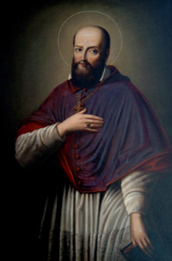
1
La Familia Salesiana en la Iglesia
Art. 7
San Francisco de Sales : Don Bosco
lo eligió como inspirador y patrono en cuanto proponía, con su obra y con sus escritos, un humanismo cristiano y una metodología
de la caridad que correspondían
bien a sus íntimas aspiraciones.

Slide 25
1
La Familia Salesiana en la Iglesia
HUMANISMO SALESIANO
Art. 7
para Don Bosco significa valorizar todo lo positivo arraigado en la vida de las personas, en las realidades creadas, en los eventos de la historia
no ignora las debilidades
del ser humano
Aspecto constitutivo de la experiencia carismática y espiritual de los Grupos fundados por Don Bosco

Slide 26
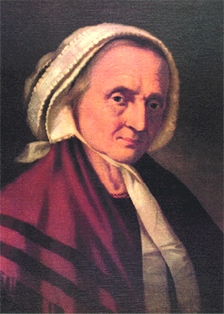
1
La Familia Salesiana en la Iglesia
Art. 8
Es sabido que Don Bosco ha recibido una importante contribución de Mamá Margarita
en la elaboración del Sistema Preventivo y en la realización del clima de familia que se experimentaba en Valdocco

Slide 27
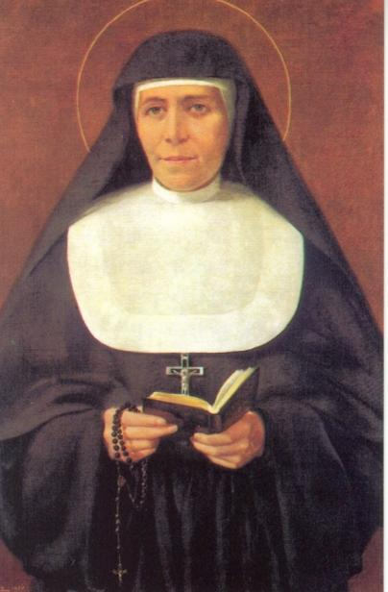
1
La Familia Salesiana en la Iglesia
Art. 8
María Dominga Mazzarello,
Supo realizar una lectura femenina de la experiencia de Don Bosco, dándole un rostro concreto y original, sea en la vida espiritual
que en la educativa y apostólica, patrimonio propio de las Hijas de María Auxiliadora.

Slide 28
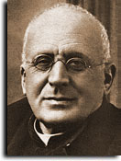

1
La Familia Salesiana en la Iglesia
Art. 8
Las primeras
Voluntarias de Don Bosco,
guiadas por Don Felipe Rinaldi, han inaugurado la secularidad consagrada femenina en la familia Salesiana: unidas entre ellas por los vínculos espirituales de los votos
de castidad, pobreza
y obediencia, han desarrollado la común misión salesiana en los contextos de la familia y del cotidiano lugar de trabajo.
Voluntarias de Don Bosco

Slide 29
1
La Familia Salesiana en la Iglesia
Art. 8
En los últimos decenios del siglo XX, una debida consideración de la mujer en los varios continentes ha llevado a los Grupos de la Familia Salesiana y, de modo particular, a las Congregaciones religiosas, a los Institutos seculares femeninos y a las Asociaciones laicales salesianas, a reflexionar sobre la valoración del genio femenino en nuestro mundo, siguiendo las orientaciones, innovadoras por tantos aspectos, del magisterio de Juan Pablo II.

Slide 30

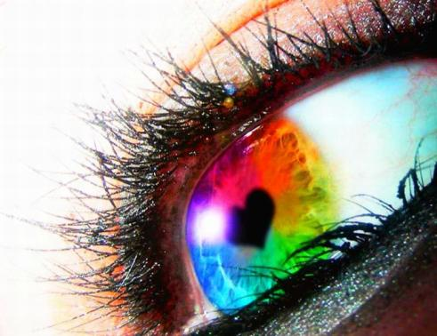
1
La Familia Salesiana en la Iglesia
Art. 9
El actual fenómeno de la globalización ha aumentado la interdependencia entre personas y entre pueblos.
Modo para interpretar la globalización es la solidaridad, inspirada y guidada por los valores evangélicos.

Slide 31
1
La Familia Salesiana en la Iglesia
Los Grupos de la Familia Salesiana ejercitan la solidaridad a través de:
Art. 9
  La forma más alta de solidaridad, si comprendida y realizada según los criterios sugeridos por la asistencia salesiana. Hoy, podríamos definirla, “ética del ser prójimo”
educación
voluntariado civil, social y misionero
  auténtica vocación, en cuanto exige disponibilidad de energías y de tiempo
  actuado sobre todo por los Grupos de miembros seculares, según los criterios expresados por el magisterio de la Iglesia
empeño social y político

Slide 32
1
La Familia Salesiana en la Iglesia
Art. 10
Cada Grupo realiza la identidad de la Familia Salesiana, pero no sin
referencia a la de los otros Grupos
Entrar a hacer parte de un Grupo,
en virtud de una específica vocación, comporta el entrar a la entera Familia
Sin los otros, los miembros de un Grupo particular no pueden
ser ellos mismos

Slide 33
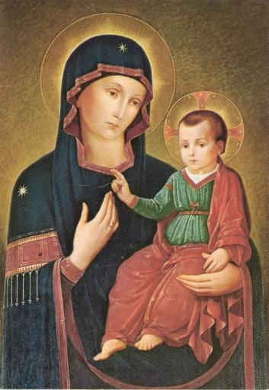
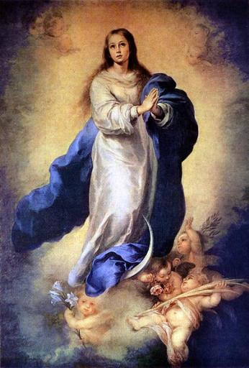
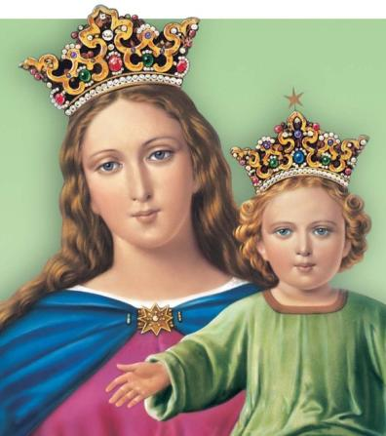
1
La Familia Salesiana en la Iglesia
Art. 11
MARÍA
Madre
Maestra

Slide 34
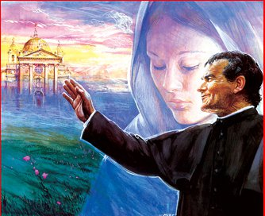
1
La Familia Salesiana en la Iglesia
Art. 11
La especial referencia a María ha marcado profundamente la identidad
carismática y espiritual de los varios
Grupos de la Familia Salesiana.
Se puede afirmar, pues, con fundamento, que la Familia Salesiana es una Familia mariana.

Slide 35
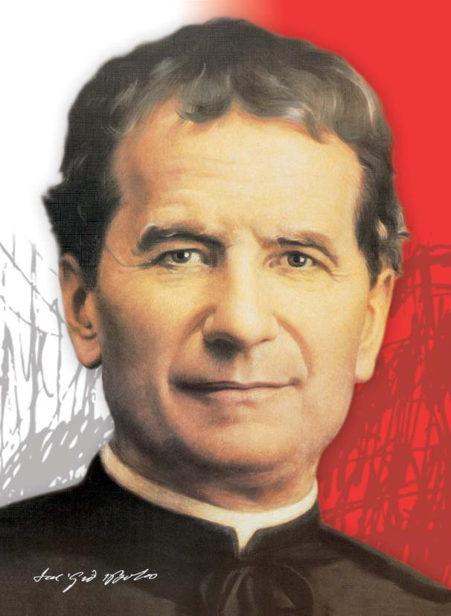
1
La Familia Salesiana en la Iglesia
Art. 12
Don Bosco es el punto
de referencia para cuantos, respondiendo a un particular impulso del Espíritu,
se sienten llamados, hoy, a compartir su misión en los varios estados de vida
y en las diversas formas
de compromiso.
Lo que liga a los diferentes Grupos y a sus miembros en una única Familia es una especie de parentesco espiritual en Don Bosco

Slide 36
1
La Familia Salesiana en la Iglesia
Art. 12
Don Bosco encontraba la fuente de su fuerza en la interioridad abierta constantemente a la relación con Dios. También para nosotros, el amor educativo
y apostólico exige una forma concreta y exigente
de interioridad.

Slide 37
1
La Familia Salesiana en la Iglesia
La pertenencia a la Familia Salesiana necesita un centro vital que actualice
el referencia a Don Bosco, a la misión común y al mismo espíritu.
Art. 13
Rector Mayor
Sucesor de Don Bosco
Padre común
Centro de unidad de la entera Familia

Slide 38
Capítulos
1
3
4
5
2
La misión de la Familia Salesiana

Slide 39
2
La misión de la Familia Salesiana
Art. 14
La misión de Don Bosco y de su Familia espiritual se inserta en la común vocación cristiana al apostolado
responde a un don espiritual,
es de origen carismático
el Espíritu del Padre y del Señor resucitado continúa enviando a sus hijos e hijas espirituales para perpetuar su apostolado juvenil, popular y misionero
Ese envío particular es mediado
por los signos de los tiempos

Slide 40
2
La misión de la Familia Salesiana
Art. 14
desarrollándose en la Iglesia y para la Iglesia, está sometida a la aprobación
de su autoridad y a su legislación
encuentra su práctica actuación en el derecho particular de cada Grupo
de la Familia Salesiana.
en el caso de las Voluntarias de Don Bosco y de los otros Institutos seculares, como también para los Salesianos Cooperadores, las Damas Salesiana y las otras Asociaciones laicales salesianas, no hay una autoridad que envía.

Slide 41

2
La misión de la Familia Salesiana
Art. 15
LA FAMILIA SALESIANA
ES UNA FAMILIA APOSTÓLICA

Slide 42

2
La misión de la Familia Salesiana
Art. 15
Don Bosco fundando la Sociedad de Sam Francisco de Sales y el Instituto de las Hijas de María Auxiliadora, los ha configurado como Congregaciones religiosas, no contemplativas sino “apostólicas”.
Todas las demás Congregaciones religiosas pertenecientes hoy a la Familia Slaesiana tienen una clara orientación apostólica y hacen parte de los institutos religiosos reconocidos como “apostólicos”.

Slide 43

2
La misión de la Familia Salesiana
Art. 15
Grupos que han surgido en los llamados lugares de “misión”
Hermanas de la Caridad de Jesús
Hermanas siervas del Corazón Inmaculado de María
Hermanas Misioneras de
María Auxilio de los Cristianos
Hermanas Catequistas
de María Inmaculada Auxiliadora
Hijas de la realeza
de María Inmaculada

Slide 44
2
La misión de la Familia Salesiana
Art. 15
Grupos que han surgido en los llamados lugares de “misión”
Hermanas Anunciadoras del Señor
Hermanas de María Auxiliatrix

Slide 45

2
La misión de la Familia Salesiana
Art. 15
Asociaciones eclesiales de tipo apostólico con el objetivo específico de actuar de modo amplio y capilar y con modalidades seculares, la misión de don Bosco y de los respectivos Fundadores.
Salesianos Cooperadores
Testigos del Resucitado
Damas Salesianas
Canción Nueva
[Canção Nova]

Slide 46
2
La misión de la Familia Salesiana
Art. 15
Todos los Institutos Seculares tienen finalidades apostólicas: desarrollan un apostolado salesiano de tipo secular en el contexto de la familia, del mundo del trabajo, de las relaciones sociales,
de los empeños civiles.
Voluntarias de Don Bosco
Hijas de la realeza
de María Inmaculada
Voluntarios con Don Bosco
Discípulos

Slide 47

2
La misión de la Familia Salesiana
Art. 15
En virtud de su particular vocación, la persona individual que pertenece a los distintos Grupos
es una persona enviada y, por tanto, llamada a desarrollar la misión común, según el rol
que se le encomienda, las capacidades
y las posibilidades propias.

Slide 48

2
La misión de la Familia Salesiana
Art. 16
JUVENIL
POPULAR
MISIONERA

Slide 49

2
La misión de la Familia Salesiana
Art. 16
JUVENIL
Los Grupos de la Familia tienen como destinatarios privilegiados a los jóvenes pobres, abandonados, en peligro o, en lenguaje moderno, la juventud masculina y femenina más necesitada de ayuda por situaciones de pobreza económica, de carencia afectiva, cultural o espiritual.
Numerosos son los Grupos que dan una atención privilegiada a los jóvenes y a las jóvenes víctimas de graves formas de marginación, sufrimiento y violencia.

Slide 50
2
La misión de la Familia Salesiana
Art. 16
POPULAR
Don Bosco se interesó también de los adultos, con preferencia de los más humildes y pobres… todos aquellos que resultaban más necesitados de ayuda material y espiritual. Fieles a la orientación de Don Bosco, los Grupos
de la Familia Salesiana comparten
esta opción preferencial.
Particular atención se da a la familia, lugar primario de humanización destinado a preparar a los jóvenes al amor y a la acogida de la vida, primera escuela de la solidaridad entre las personas y los pueblos.

Slide 51

2
La misión de la Familia Salesiana
Art. 16
MISIONERA
Don Bosco… quiso que la Sociedad Salesiana y el Instituto de las Hijas de María Auxiliadora se dedicaran a las “misiones”, y fue eso lo que hicieron las dos Congregaciones religiosas desde
sus orígenes, con una extraordinaria expansión que las ha hecho presentes
en todos los continentes.
La cooperación misionera ha sido también, desde su inicio, una dimensión esencial de muchos otros Grupos

Slide 52
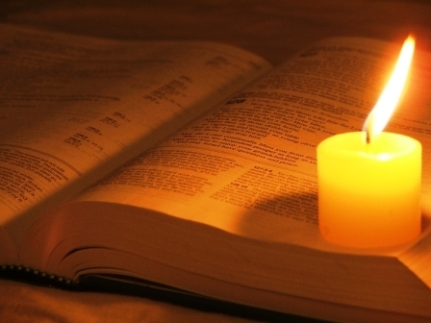
2
La misión de la Familia Salesiana
Art. 17
Siguiendo el ejemplo y la enseñanza de Jesús de Nazaret, la Iglesia y,
en ella, la Familia Salesiana, se ponen al servicio (diaconía) de la humanidad, para anunciar el Evangelio y llamar
a todos a la plenitud de la vida.

Slide 53
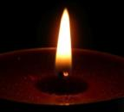

2
La misión de la Familia Salesiana
Art. 17
Servicio que comprende…
renovación de la sociedad
con obras sociales
testimonio cristiano personal
y comunitario
el anuncio explícito del Evangelio
trabajo misionero a través
del diálogo interreligioso

Slide 54
2
La misión de la Familia Salesiana
Art. 17
Servicio que comprende…
animación de la oración
iniciativas de solidaridad
humana y cristiana
formas de cooperación misionera
presencia evangelizadora

Slide 55
2
La misión de la Familia Salesiana
Art. 17
Formar «buenos cristianos y honestos ciudadanos»
Es una intencionalidad muchas veces expresada por Don Bosco. La experiencia educativa le sugiere un proyecto y un particular estilo de intervención, condensados por él mismo en el Sistema preventivo, que “se apoya todo sobre la razón, la religión y el amor [amorevolezza]”.

Slide 56
2
La misión de la Familia Salesiana
Art. 17
Para todos los Grupos la evangelización, entendida como anuncio y testimonio del Evangelio, es el
objetivo prioritario
de la propia misión.

Slide 57

2
La misión de la Familia Salesiana
Art. 18
Opciones fundamentales para
el compromiso misionero
1
2
3
4
Promover
el humanismo
salesiano
asumir el desafío
de la comunicación
social
cuidar la
significatividad
insertarse en las
situaciones concretas

Slide 58
2
La misión de la Familia Salesiana
Art. 18
Opciones fundamentales para el compromiso misionero
1
Promover el humanismo salesiano
Coloca al centro a la persona,
cuya dignidad debe tutelarse y promoverse en todas
sus expresiones.
Aprecia todos los valores auténticamente humanos.
Tales valores deben defenderse
y promoverse por parte de todos

Slide 59
2
La misión de la Familia Salesiana
Art. 18
Opciones fundamentales para el compromiso misionero
2
Insertarse en las situaciones concretas
Comprometerse con la persona.
Individuar posibles intervenciones y respuestas eficaces a las exigencias emergentes, inspirándose siempre en las orientaciones del Papa y del episcopado local.

Slide 60
2
La misión de la Familia Salesiana
Art. 18
Opciones fundamentales para el compromiso misionero
3
Cuidado de la significatividad
Defensa y promoción
e los valores éticos.
Defensa de los derechos de aquellos que son los más débiles y expuestos.
Presencia eficaz en las instancias políticas, donde se elaboran las políticas educativas.
Promoción de una opinión pública nutrida por valores humanos, evangélicos y salesianos.

Slide 61
2
La misión de la Familia Salesiana
Art. 18
Opciones fundamentales para el compromiso misionero
4
Asumir el desafío de la comunicación social
Instrumento de crecimiento personal y comunitario es, a la vez,
defensa y promoción de la fe de
los sectores populares.
Oportunidad de educación
y de evangelización.
Las conexiones en red y la comunicación a distancia permiten realizar varias formas de intervención y activar sinergias que no eran pensables en el pasado.

Slide 62

2
La misión de la Familia Salesiana
Art. 19
El nexo que une a los miembros de nuestra Familia es el de una «comunión misionera».
El actuar juntos intensifica
la eficacia del testimonio,
hace más convincente
el anuncio del Evangelio, favorece una caridad
apostólica más vivaz y permite profundizar los rasgos característicos de cada Grupo,
al tiempo que manifiesta y potencia la identidad de la Familia, en la comunión
y en la misión.

Slide 63

2
La misión de la Familia Salesiana
Art. 20
comunión en y por
la misión
los diversos Grupos gozan, en efecto, de una propia autonomía::
espiritual,
formativa,
económica,
de gobierno,
apostólica
actuando la misión en estructuras
propias y según modalidades peculiares.

Slide 64

2
La misión de la Familia Salesiana
Art. 21
La corresponsabilidad exige, como condición previa,
que cada Grupo asegure
una capacidad autonomía.
Y la realización
de la vocación
y misión específicas
garantiza la vitalidad,
fruto de fidelidad
y de creatividad.

Slide 65

2
La misión de la Familia Salesiana
Art. 21
Son deseables:
Colaboraciones entre Grupo y Grupo para realizar la misión salesiana, en sus diversos sectores y campos, y en los diversos tipos de obra.

Slide 66
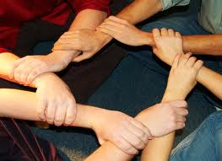
2
La misión de la Familia Salesiana
Art. 21
Son deseables:
La colaboración de los Grupos que viven y actúan en el mismo territorio, en conexión con las estructuras pastorales de la Iglesia local y las instituciones civiles, que permita ofrecer el aporte salesiano, variado en su riquezas y contenidos, a la común construcción
de la civilización del amor.

Slide 67

2
La misión de la Familia Salesiana
Art. 21
La corresponsabilidad requiere, en todo caso,
el compromiso común
de alcanzar algunos
objetivos compartidos.

Slide 68
2
La misión de la Familia Salesiana
Art. 21
2
3
4
1
Difundir el espíritu salesiano, con el testimonio y
con la palabra
hacer conocer
el Sistema preventivo
Promover
el Movimiento salesiano
Compartir la preocupación educativa

Slide 69
Capítulos
1
2
4
5
3
La espiritualidad de la Familia Salesiana

Slide 70
3
La espiritualidad de la Familia Salesiana
Art. 22
La espiritualidad apostólica
es el centro inspirador
y animador de la vida
de comunión, en y por la misión, de la Familia Salesiana

Slide 71
3
La espiritualidad de la Familia Salesiana
Art. 22
Nuestra vida está
guiada por el Espíritu
Espiritualidad
Apostólica
dinamismo interior que
estimula al don y al servicio

Slide 72
3
La espiritualidad de la Familia Salesiana
Art. 22
Movidos por la fe, la esperanza
y la caridad, los miembros de
la Familia Salesiana participan
en la acción de Dios, que siempre actúa para comunicar a toda persona su amor misericordioso; y se sienten profundamente insertos en la comunión y en
el apostolado de la Iglesia.

Slide 73
3
La espiritualidad de la Familia Salesiana
Art. 23
Centro unificador
de la propia vida
fuente
de la comunión fraterna
inspirador
DIOS
de acciones

Slide 74
3
La espiritualidad de la Familia Salesiana
Art. 23
VIVIR EN LA PRESENCIA
DE DIOS
cultivar una intensa y continua
relación de amor con Él
sentirse colmados, por tanto,
de una amor semejante al Suyo
saber percibir y acoger los signos
de su misteriosa presencia
en las expectativas y en las peticiones
de los hombres y de las mujeres
de nuestro tiempo

Slide 75
3
La espiritualidad de la Familia Salesiana
Art. 23
Es a este Dios,
Padre misericordioso,
a quien Don Bosco ha dirigido
su sentida invocación:
DA MIHI ANIMAS,
CETERA TOLLE

Slide 76
3
La espiritualidad de la Familia Salesiana
Art. 24
«Tened entre vosotros los mismos sentimientos
que Cristo Jesús» (Fil 2,5).
Conciencia atenta de ser enviados
de Dios
Incondicional obediencia a la voluntad
del Padre,
al cumplir
la misión confiada
Constante
y generoso compromiso para liberar
a las personas de toda forma de muerte
y comunicar
a todos vida
y alegría

Slide 77
3
La espiritualidad de la Familia Salesiana
Art. 24
«Tened entre vosotros los mismos sentimientos
que Cristo Jesús» (Fil 2,5).
cuidado apasionado de los pequeños
y de los pobres, con la solicitud del Buen Pastor
amor que perdona siempre, hasta volverse víctima sobre la cruz
promesa de ser compañero de camino de sus discípulos como lo fue para los dos
de Emaús.

Slide 78
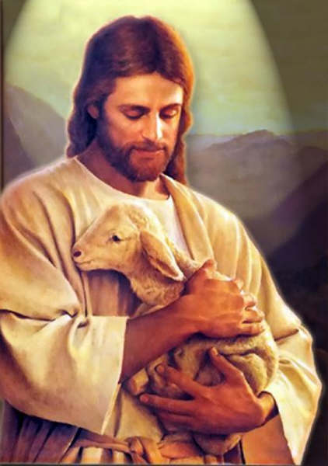
3
La espiritualidad de la Familia Salesiana
Art. 24
Es el icono del Buen Pastor, en particular, el que inspira
y guía nuestra acción

Slide 79
3
La espiritualidad de la Familia Salesiana
Art. 24
El/la apóstol del Señor Jesús coloca al centro
de su atención a la persona en cuanto tal,
y la ama como es, sin prejuicios o exclusiones,
así como hace el Buen Pastor, también
con la oveja descarriada
El/la apóstol no se propone a sí mismo/a, sino siempre y sólo al Señor Jesús, el único que puede liberar de toda forma de esclavitud,
el único que puede conducir a los pastos
de vida eterna, el único que jamás
abandona a quien está perdido

Slide 80

3
La espiritualidad de la Familia Salesiana
Art. 25
Dóciles al Espíritu Santo…
La Familia Salesiana
ha tratado de profundizar
las relaciones
con el Espíritu del Señor Resucitado, definiendo
la propia identidad
en torno al carisma
de Don Bosco,
don verdadero
del Espíritu y fuente
de la espiritualidad
que anima
a su Familia apostólica.

Slide 81
3
La espiritualidad de la Familia Salesiana
Art. 25
Dóciles al Espíritu Santo…
es Creador y da la vida
es enviado por el Padre y por el Resucitado
es el que introduce a los creyentes en la Verdad/Cristo
es Voz que habla en la conciencia de las personas
es Presencia viva y eficaz en las comunidades cristianas
es Aquel que precede, asiste y acompaña

Slide 82
3
La espiritualidad de la Familia Salesiana
Art. 25
Con actitud de…
Serenidad y eficacia
Docilidad a sus secretas inspiraciones
Sabio discernimiento
de su presencia
Sabia y valiente colaboración a su acción

Slide 83

3
La espiritualidad de la Familia Salesiana
Art. 26
«Cualquier fatiga es poca, cuando se trata
de la Iglesia y del Papa». «Cuando el Papa nos manifiesta un deseo,
es para nosotros
una orden».
Esta adhesión incondicional al Papa expresa,
en Don Bosco, su pasión
por la Iglesia.
Es una herencia que nosotros
acogemos y vivimos.

Slide 84
3
La espiritualidad de la Familia Salesiana
Art. 27
Don Bosco se inspiró en San Francisco de Sales para una ESPIRITUALIDAD…
sencilla
  porque esencial
popular
  porque abierta a todos
simpática
  porque preñada de valores humanos y, por ello, particularmente apta para la acción educativa

Slide 85
3
La espiritualidad de la Familia Salesiana
Art. 27
El santo Obispo de Ginebra habla de “éxtasis”
Éxtasis intelectual
y estupor por lo que Dios
Éxtasis afectivo
y hacer experiencia personal del amor de Dios
Éxtasis de la acción y de la vida
revela una generosidad y una gratuidad che sólo pueden venir de Dios

Slide 86
3
La espiritualidad de la Familia Salesiana
Art. 27
La Familia Salesiana, en la relectura de Don Bosco Fundador, ha traducido las exigencias de la espiritualidad
y de la mística de San Francisco
de Sales con una formulación sencilla
y desafiante:
espiritualidad
del cotidiano

Slide 87
3
La espiritualidad de la Familia Salesiana
Art. 28
Da mihi animas, cetera tolle
Éxtasis de la acción
Es la mística de un actuar cotidiano en sintonía de pensamiento, de sentimiento y de voluntad con Dios: por ella, las necesidades de los hermanos, en particular de los jóvenes,
y las preocupaciones apostólicas
invitan a la oración, mientras que
la oración constante alimenta el actuar
con Dios, generoso y sacrificado,
por el bien de los hermanos.

Slide 88
3
La espiritualidad de la Familia Salesiana
Art. 28
Es la mística de la “contemplación en la acción”, así descrita por el beato Don Felipe Rinaldi
La Familia Salesiana asume esta mística, tan intensamente vivida por Don Bosco,
y por él dejada como
preciosa herencia a sus discípulos/discípulas espirituales

Slide 89

3
La espiritualidad de la Familia Salesiana
Art. 29
Apostólica
Caridad
Dinámica

Slide 90

3
La espiritualidad de la Familia Salesiana
Art. 29
Caridad
es el nombre de Dios
… es participación de la misericordia preventiva del Padre, del corazón compasivo de Cristo y del indecible amor del Espíritu Santo.
Es éste el distintivo de los discípulos del Señor: amarse lo unos a los otros con el mismo amor con el que Dios ama.

Slide 91
3
La espiritualidad de la Familia Salesiana
Art. 29
Apostólica
es participación del amor infinito del Padre…
… es un compartir de la premura del Buen Pastor por la salvación de todos;
… es apertura al flujo de amor con el cual el Espíritu actúa en las conciencias y en la historia de las personas.

Slide 92
3
La espiritualidad de la Familia Salesiana
Art. 29
Dinámica
Expresa vivacidad de movimiento
Buscar, con pasión y creatividad,
lo que es más necesario y eficaz
para responder concretamente a
las expectativas del universo juvenil
y de la clase popular.

Slide 93

3
La espiritualidad de la Familia Salesiana
Art. 29
Para Don Bosco todo esto asume
el nombre de corazón oratoriano
Celo
Solicitud
Búsqueda de nuevas intervenciones
Puesta a disposición de todos los recursos
Optimismo cultivado y extendido
fervor
Capacidad de resistir en las pruebas
Recuperación tras las derrotas

Slide 94
3
La espiritualidad de la Familia Salesiana
Art. 30
Evangelizar educando
Educar evangelizando
cuando uno se deja guiar
por el Espíritu, vida y apostolado
forman un solo bloque
oración
acción
amor a Dios
amor al prójimo
cuidado de sí mismos
dedicación a los demás

Slide 95
3
La espiritualidad de la Familia Salesiana
Art. 30
Evangelizar educando
Educar evangelizando
Educación
anuncio del evangelio
Todo converge en unidad…
… es la síntesis vital propia de la santidad
Pertenencia a un grupo
inserción
en la Iglesia

Slide 96
3
La espiritualidad de la Familia Salesiana
Art. 30
Evangelizar educando Educar evangelizando
La caridad pastoral es el principio
interior y dinámico capaz de unificar
las múltiples y diversas actividades
y preocupaciones cotidianas.
Favorece la fusión en un único movimiento interior, de los dos polos inseparables de la caridad apostólica:
pasión por Dios
pasión por el prójimo

Slide 97
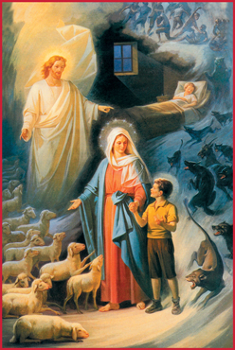
3
La espiritualidad de la Familia Salesiana
Art. 31
Los jóvenes son reconocidos como don de Dios a la Familia Salesiana: son el campo indicado por Dios
y por María a Bosco;
son para todos nosotros sustancia de la vocación y de la misión salesiana.

Slide 98

3
La espiritualidad de la Familia Salesiana
Art. 32
La amabilidad de Don Bosco…
no es reducible a un simple principio pedagógico, sino
que ha de reconocerse como
elemento esencial
de nuestra espiritualidad
¡Para el educador es un amor que exige fuertes energías espirituales!

Slide 99
3
La espiritualidad de la Familia Salesiana
Art. 32
La amabilidad
de Don Bosco… exige
voluntad de ser y de estar allí
renuncia de sí y sacrificio
castidad de los afectos
autocontrol de las actitudes
escucha participante

Slide 100
3
La espiritualidad de la Familia Salesiana
Art. 32
La amabilidad de Don Bosco exige…
espera paciente
capacidad de perdonar
mansedumbre
creer con esperanza ilimitada

Slide 101
3
La espiritualidad de la Familia Salesiana
Art. 32
No existe amor verdadero
sin ascética; y no existe
ascética sin encuentro c
on Dios en la oración.
La espiritualidad apostólica
de la Familia Salesiana se caracteriza
no por un amor entendido genéricamente, sino por la capacidad de amar
y de hacerse amar.

Slide 102
3
La espiritualidad de la Familia Salesiana
Art. 33
Don Bosco ha sabido captar el deseo de felicidad presente en los jóvenes
y ha declinado su gozo de vivir
en los lenguajes de la alegría, del patio
y de la fiesta; pero nunca ha dejado
de señalar a Dios como fuente
de la verdadera alegría.

Slide 103
3
La espiritualidad de la Familia Salesiana
Art. 33
En la escuela de Don Bosco,
el que pertenece a la Familia Salesiana cultiva, dentro de sí, algunas actitudes que favorecen la alegría y que la comunican a los demás.
confianza en la victoria del bien
estima de los valores humanos
educación para las alegrías cotidianas

Slide 104
3
La espiritualidad de la Familia Salesiana
Art. 34
despojarse
darse
llenarse
a los demás
de Dios

Slide 105
3
La espiritualidad de la Familia Salesiana
Art. 34
renuncia
tomar
distancia
sacrificio
lógica del amor

Slide 106
3
La espiritualidad de la Familia Salesiana
Art. 34
La ascesis recomendada por Don Bosco
ascesis del valor
y de la paciencia
ascesis de la mortificación
ascesis del abandono
ascesis de la humildad

Slide 107

3
La espiritualidad de la Familia Salesiana
Art. 35
«En las cosas que se tornan en ventaja de la juventud en peligro, o que sirven para ganar almas para Dios, yo corro adelante hasta la temeridad» (Don Bosco)
El deseo de hacer el bien
compromete a buscar los caminos
más aptos para realizarlo.

Slide 108
3
La espiritualidad de la Familia Salesiana
Art. 36
La oración salesiana es una ORACIÓN APOSTÓLICA
AZIONE
VIDA
ORACIÓN
DIO

Slide 109
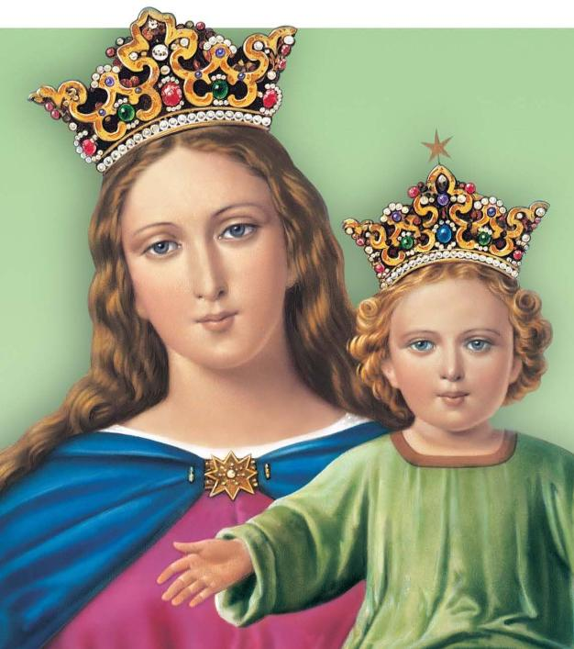
modello e guida nella loro azione educativa e apostolica,^{[1]} madre e maestra nella loro esperienza formativa,^{[2]}
^{[1]} Cf. Cost SDB artt. 20 34 92.
^{[2]} Cf. Ivi art. 98.
3
La espiritualidad de la Familia Salesiana
Art. 37
la Familia Salesiana
FAMILIA MARIANA
modelo y guía de la acción educativa y apostólica, madre y maestra de las experiencias formativas

Slide 110
Capítulos
1
2
3
5
4
Formación para la comunión
y la misión en la Familia Salesiana

Slide 111
Formación para la comunión
y la misión en la Familia Salesiana
4
Art. 38
La comunión de la Familia Salesiana se basa en:
común carisma
la misma misión;
conocimiento y
aprecio.
La unidad no es uniformidad, sino
Pluralidad de expresiones
convergentes
hacia un único centro.

Slide 112

Formación para la comunión
y la misión en la Familia Salesiana
4
Art. 39
formarse juntos
pensar juntos
orar juntos
trabajar juntos

Slide 113

Formación para la comunión
y la misión en la Familia Salesiana
4
Art. 40
insertarse en contextos culturales, sociales y eclesiales diversificados…
...estimulados por el ejemplo
de Don Bosco… somos llamados
a reconfirmar el don recibido, compartiéndolo con toda la Iglesia

Slide 114
Formación para la comunión
y la misión en la Familia Salesiana
4
Art. 41
Compartir los proyectos
lógicas de la coordinación
lógica de la reciprocidad
responsabilidad compartida

Slide 115

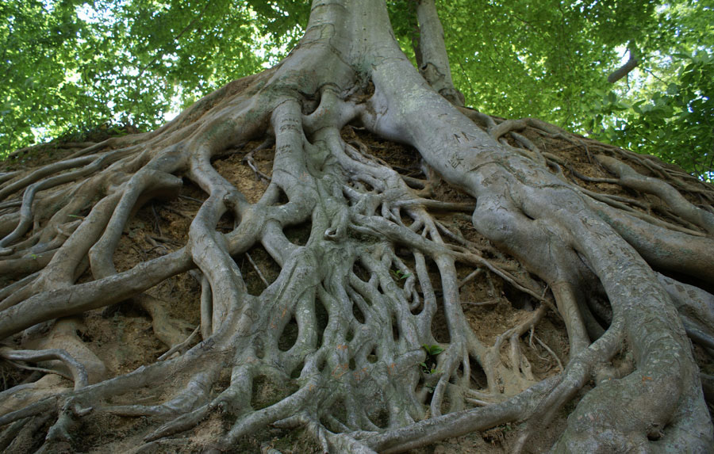
Formación para la comunión
y la misión en la Familia Salesiana
4
Art. 42
una familia apostólica como la salesiana asume como raíz
y como centro
la celebración de la Eucaristía

Slide 116
Capítulos
1
2
3
4
5
Composición y animación
de la Familia Salesiana (FS)

Slide 117
5
Composición y animación de la FS
Art. 43
La vocación de nuestra Familia está la servicio de la misión,
en modo particular para
la salvación de la juventud, especialmente la más pobre, abandonada y en peligro.

Slide 118
5
Composición y animación de la FS
Art. 44
Criterios esenciales…
participación en la “vocación salesiana”
participación en la misión juvenil popular salesiana
compartir el espíritu, el método educativo y el estilo misionero
la vida evangélica según el espíritu salesiano
Una fraternidad activa

Slide 119
5
Composición y animación de la FS
Art. 45
El Rector Mayor, Sucesor de Don Bosco, es el Padre y el centro de unidad de la Familia.
Los Salesianos de Don Bosco animan el conjunto
de la Familia Salesiana.

Slide 120
5
Composición y animación de la FS
Art. 46
Organización de coordinación…
mundial
local
inspectorial
nacional
regional

Slide 121
5
Composición y animación de la FS
Art. 46
Consulta…
Estudiar
y profundizar
la figura de don Bosco
Activar iniciativas apostólicas concretas, compartidas por todos los grupos del territorio.
Conocer los desafíos pastorales de la sociedad y de la Iglesia local
Proponer encuentros
y experiencias
de formación en común
Reforzar el sentido de pertenencia

Slide 122
5
Composición y animación de la FS
Padre y Maestro de la juventud,
San Juan Bosco,
que, dócil a los dones del Espíritu sa nto,
has dejado en herencia a la Familia Salesiana
el tesoro de tu predilección por “los pequeños y los pobres”,
enséñanos a ser cada día, para ellos,
signos y portadores del amor de Dios,
cultivando en nuestro ánimo los mismos sentimientos
de Cristo Buen Pastor.
Art. 47
Pide para todos los miembros de nuestra Familia,
un corazón lleno de bondad, constancia en el trabajo,
sabiduría en el discernimiento,
valor para testimoniar el sentido de Iglesia,
y generosidad misionera.
Obtennos del Señor, para nosotros,
la gracia de ser fieles a la alianza especial
que el Señor ha hecho con nosotros;
y haz que, guiados por María Auxiliadora,
recorramos con alegría, junto con los jóvenes,
el camino que conduce al Amor.
Amén.

